Slide 1
Hawaii Vacation
Task 4

Slide 2
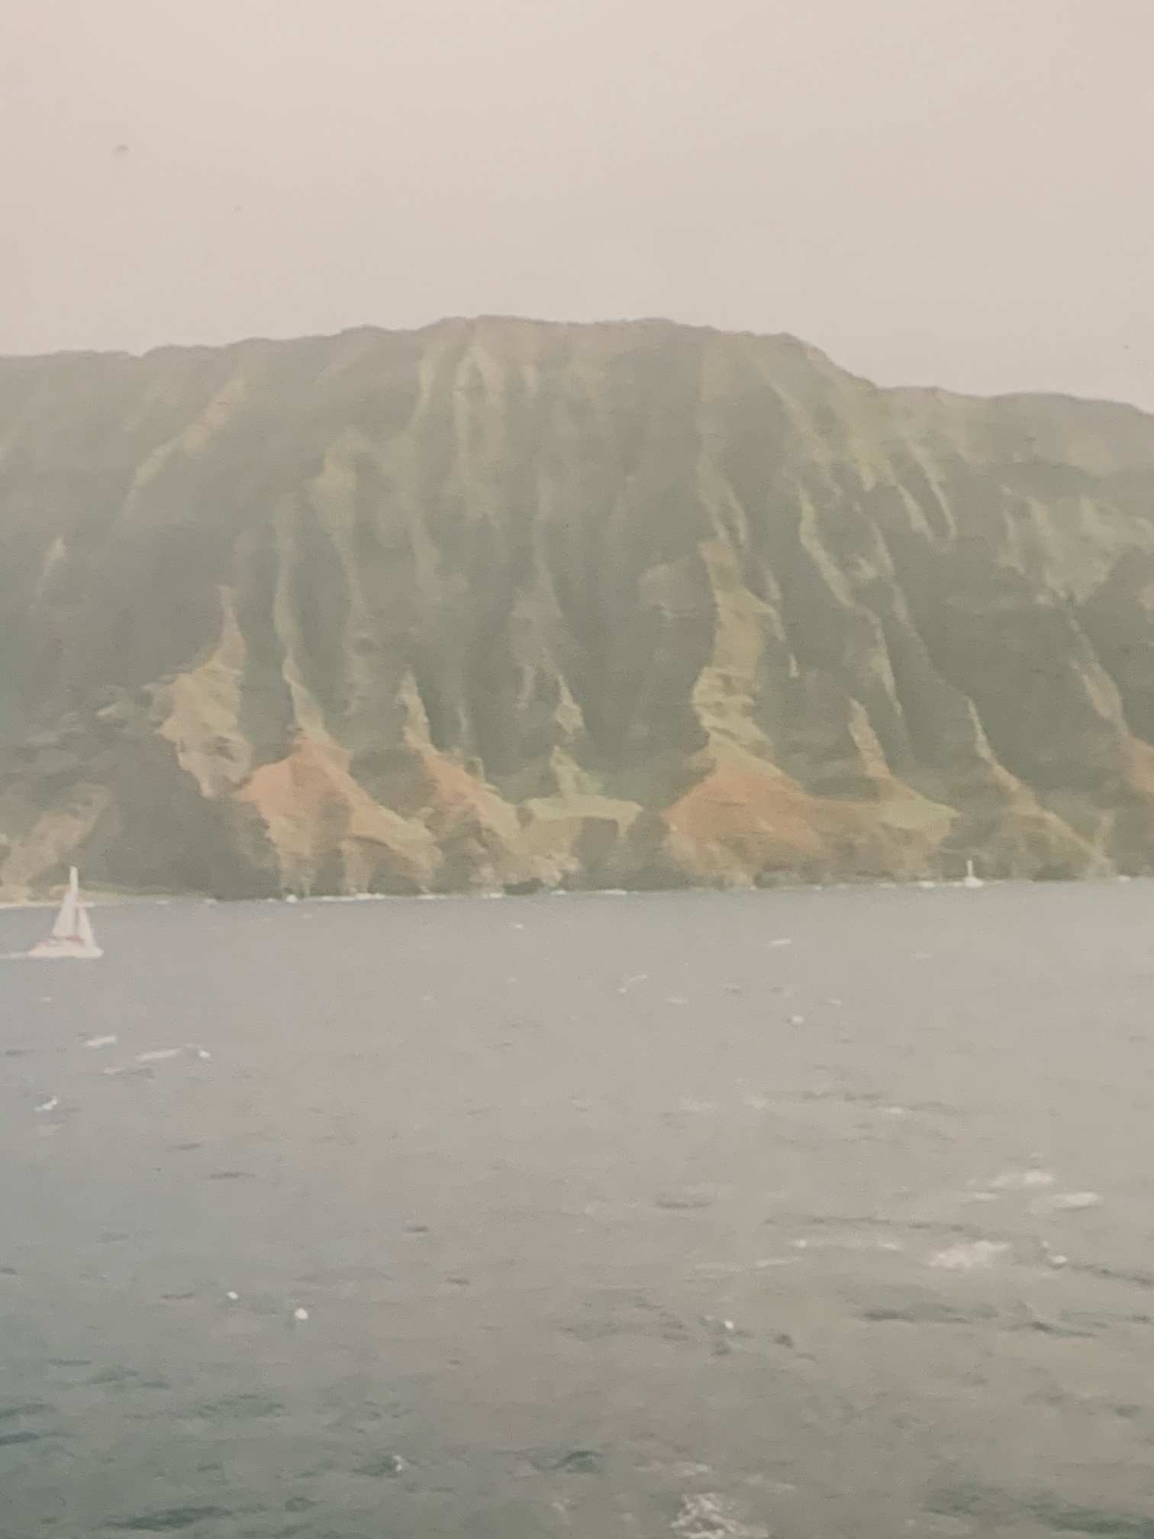

Slide 3
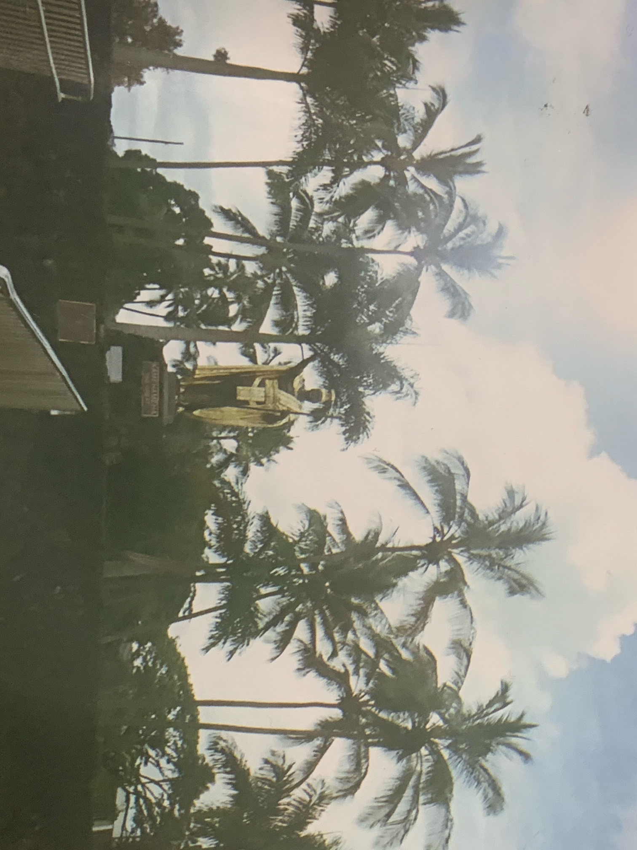

Slide 4
